Slide 1

MACROECONOMIC
Romania’s growth slowdown probably bottomed out, fiscal measures to halt disinflation temporarily, fiscal risks are high
Quarterly report,
February 2024

Slide 2

ROMANIA’S Growth SLOWDOWN PROBABLY BOTTOMED OUT, fiscal measures to halt disinflation temporarILy, fiscal risks increased
GDP growth slowdown probably bottomed out. However, the recovery will be slow as industry and the services sector struggle, and euro area is close to recession
Inflation is declining, but the fiscal measures halt disinflation in January.
The central bank could keep the rate at the current level until 2024H2.
Further fiscal measures are needed to bring the budget deficit in line with the 3% target. The new pension law is a game changer
Credit markets have also started a slow recovery.
PRESS
HIGHLIGHTS

Slide 3

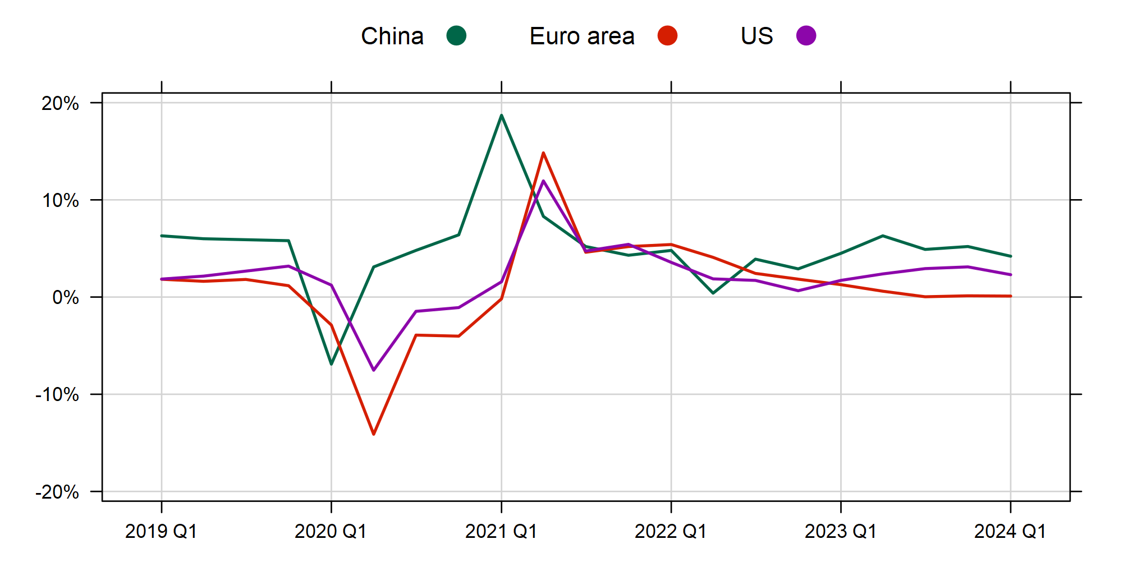
GLOBAL GROWTH TO REMAIN WEAK IN Q1
Quarterly GDP growth rates (YoY, %)
GLOBAL
ECONOMY
Source: Bloomberg

Slide 4
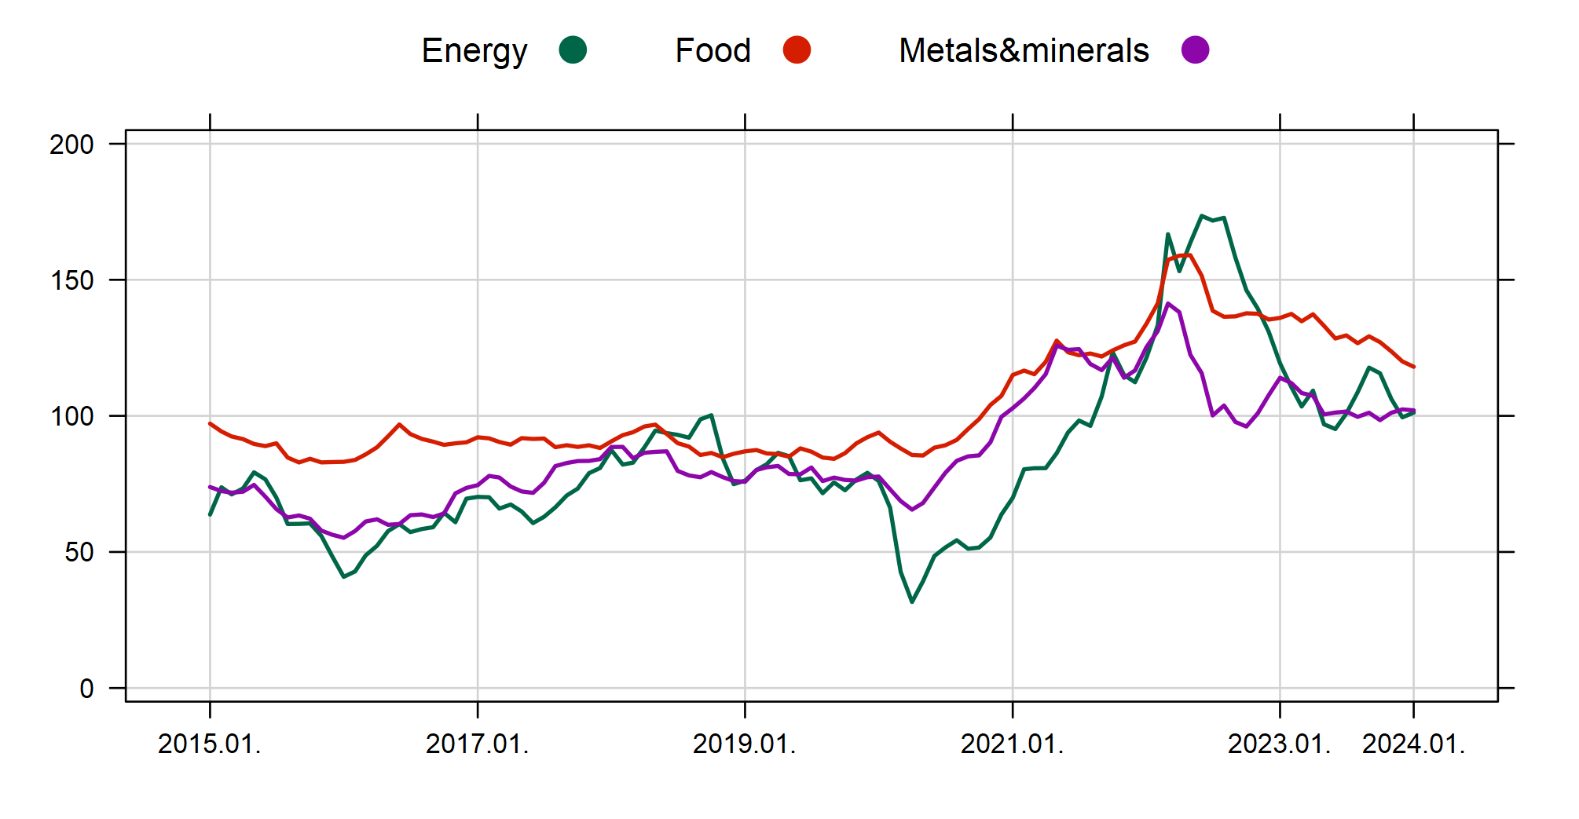
GLOBAL COMMODITY PRICES DECLINE AMIDST GEOPOLITICAL UNCERTAINTY
Commodity prices (2010=100)
GLOBAL
ECONOMY
Source: Bloomberg

Slide 5
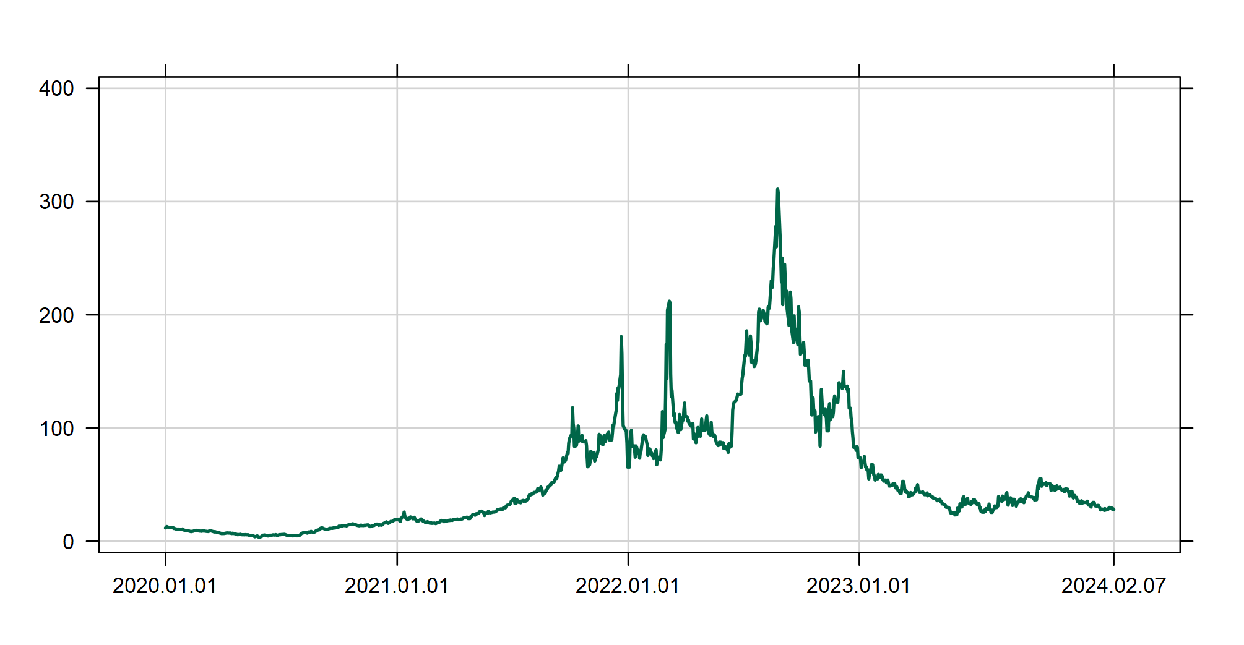
GAS AND OIL PRICES REMAINED ROUGHLY STABLE
TTF natural gas price (EUR/MWH)
GLOBAL
ECONOMY
Source: Bloomberg
Brent oil price(USD/barrel)
Source: Bloomberg

Slide 6
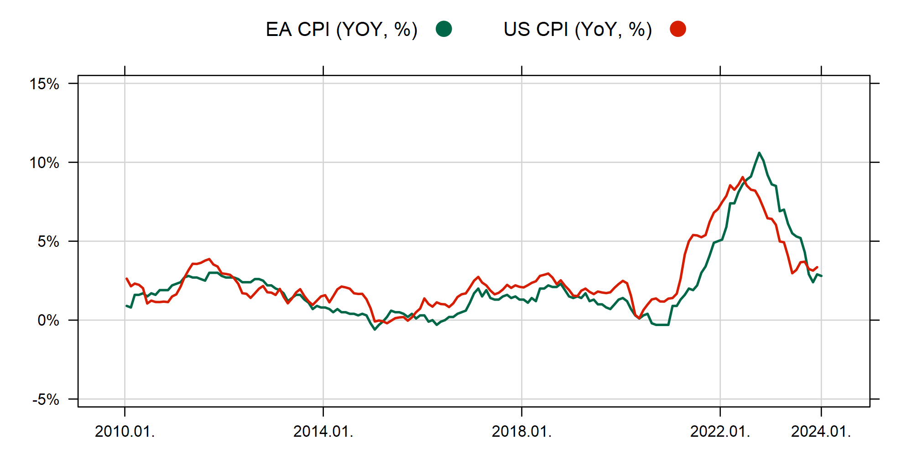
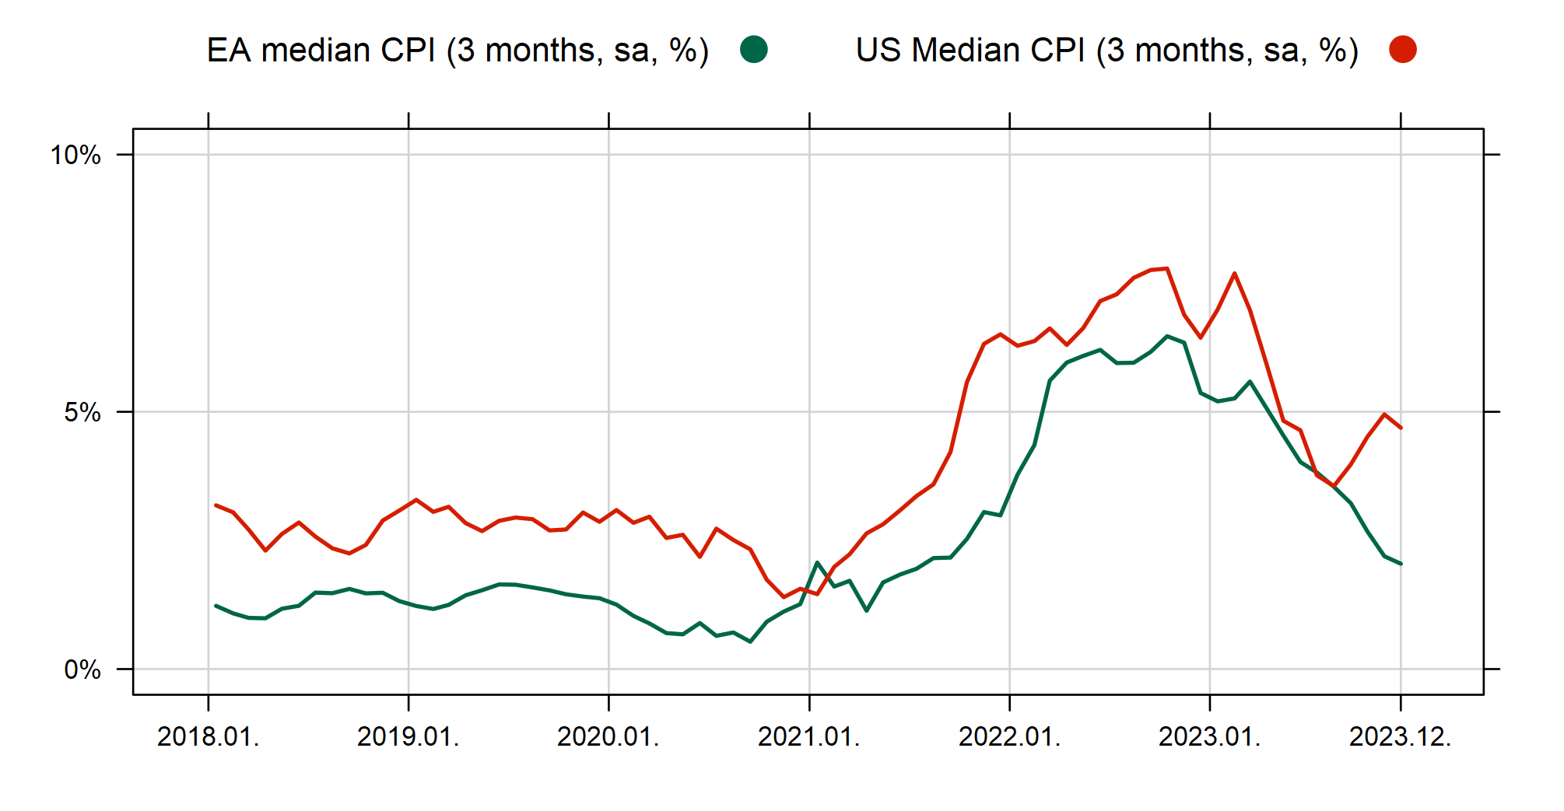
BOTH, US AND EURO AREA TREND INFLATION ARE COMING DOWN, BUT EUROZONE’S DISINFLATION SEEMS QUICKER
Inflation rates (YoY, %)
GLOBAL
ECONOMY
Source: Refinitive
Underlying inflation indicators
3 months change, sa, %)
Source: Refinitiv, Eurostat, OTP Research

Slide 7
MARKETS PRICE 5 RATE CUTS THIS YEAR, BUT THIS COULD BE TOO OPTIMISTIC
Market expectation of central bank rates, %
GLOBAL
ECONOMY
Source: Bloomberg

Slide 8
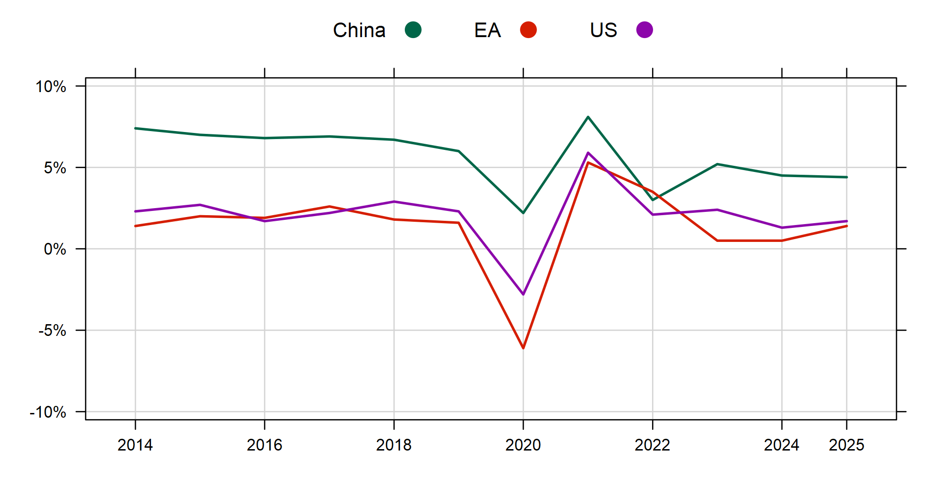
GLOBAL GROWTH TO recover slowly as headwinds ease
GDP growth outlook (YoY, %)
GLOBAL
ECONOMY
Source: Bloomberg

Slide 9
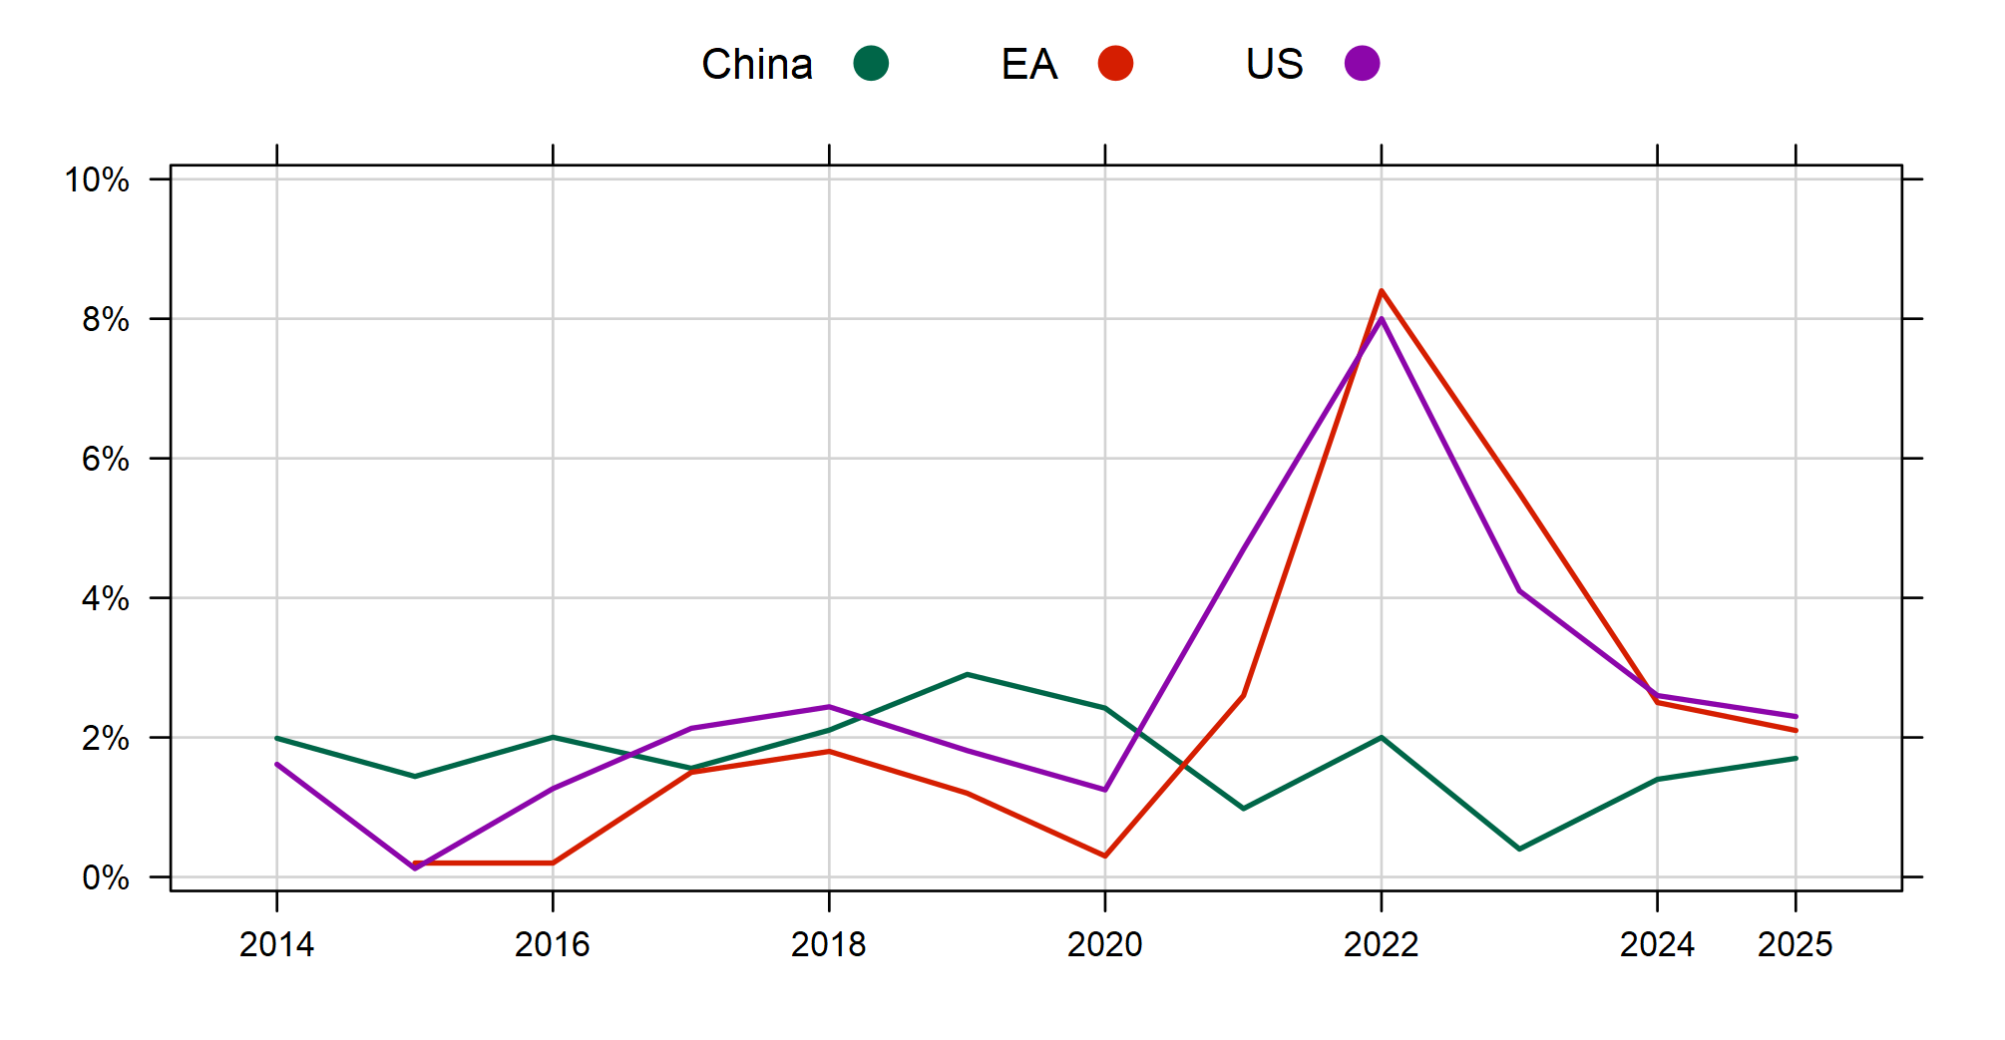
Inflation WILL REACH THE TARGETS IN 2025 IN THE usa AND Euro area
Inflation outlook (YoY, %)
GLOBAL
ECONOMY
Source: Bloomberg

Slide 10

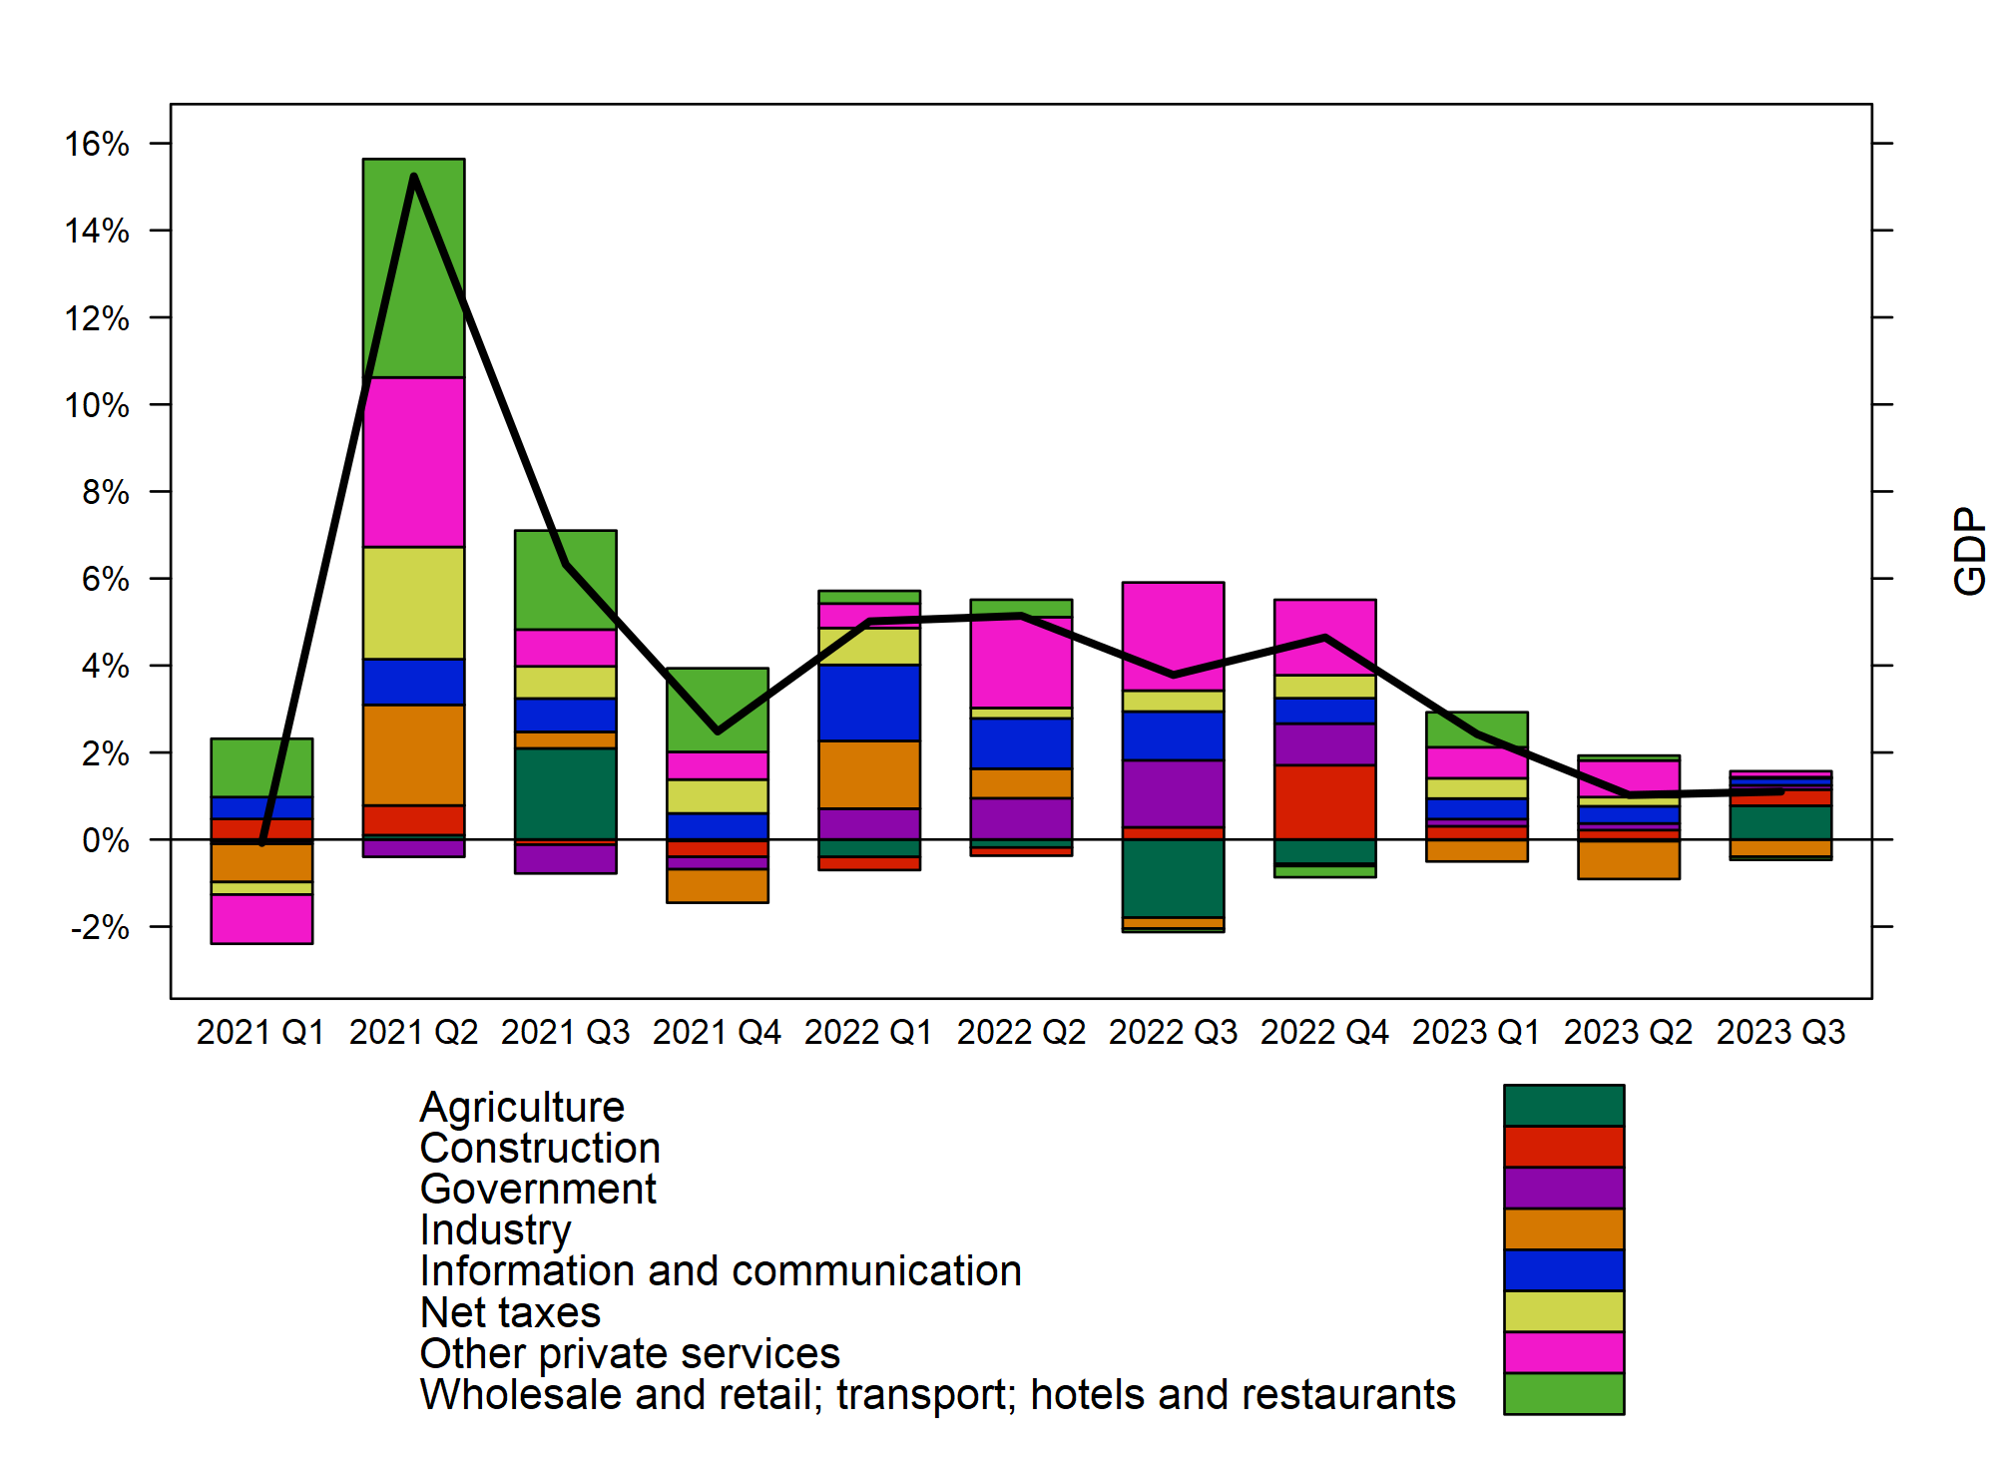
ROMANIA’S Q3 YOY GDP AT 1.1%
GDP growth and it’s sectoral components, YoY, %
REAL
ECONOMY
Source: NIS, OTP Bank

Slide 11
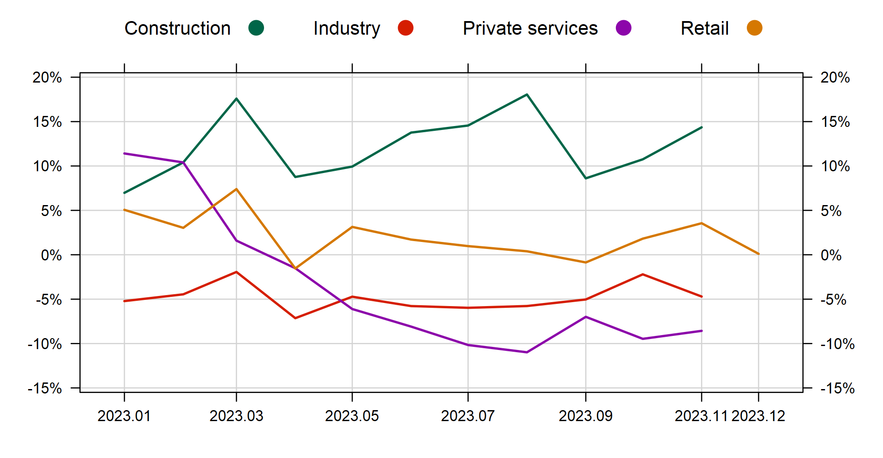
Q4 SUGGESTS SOME IMPROVEMENT
Key monthly indicators, YoY,%
REAL
ECONOMY
Source: NIS, OTP Bank

Slide 12

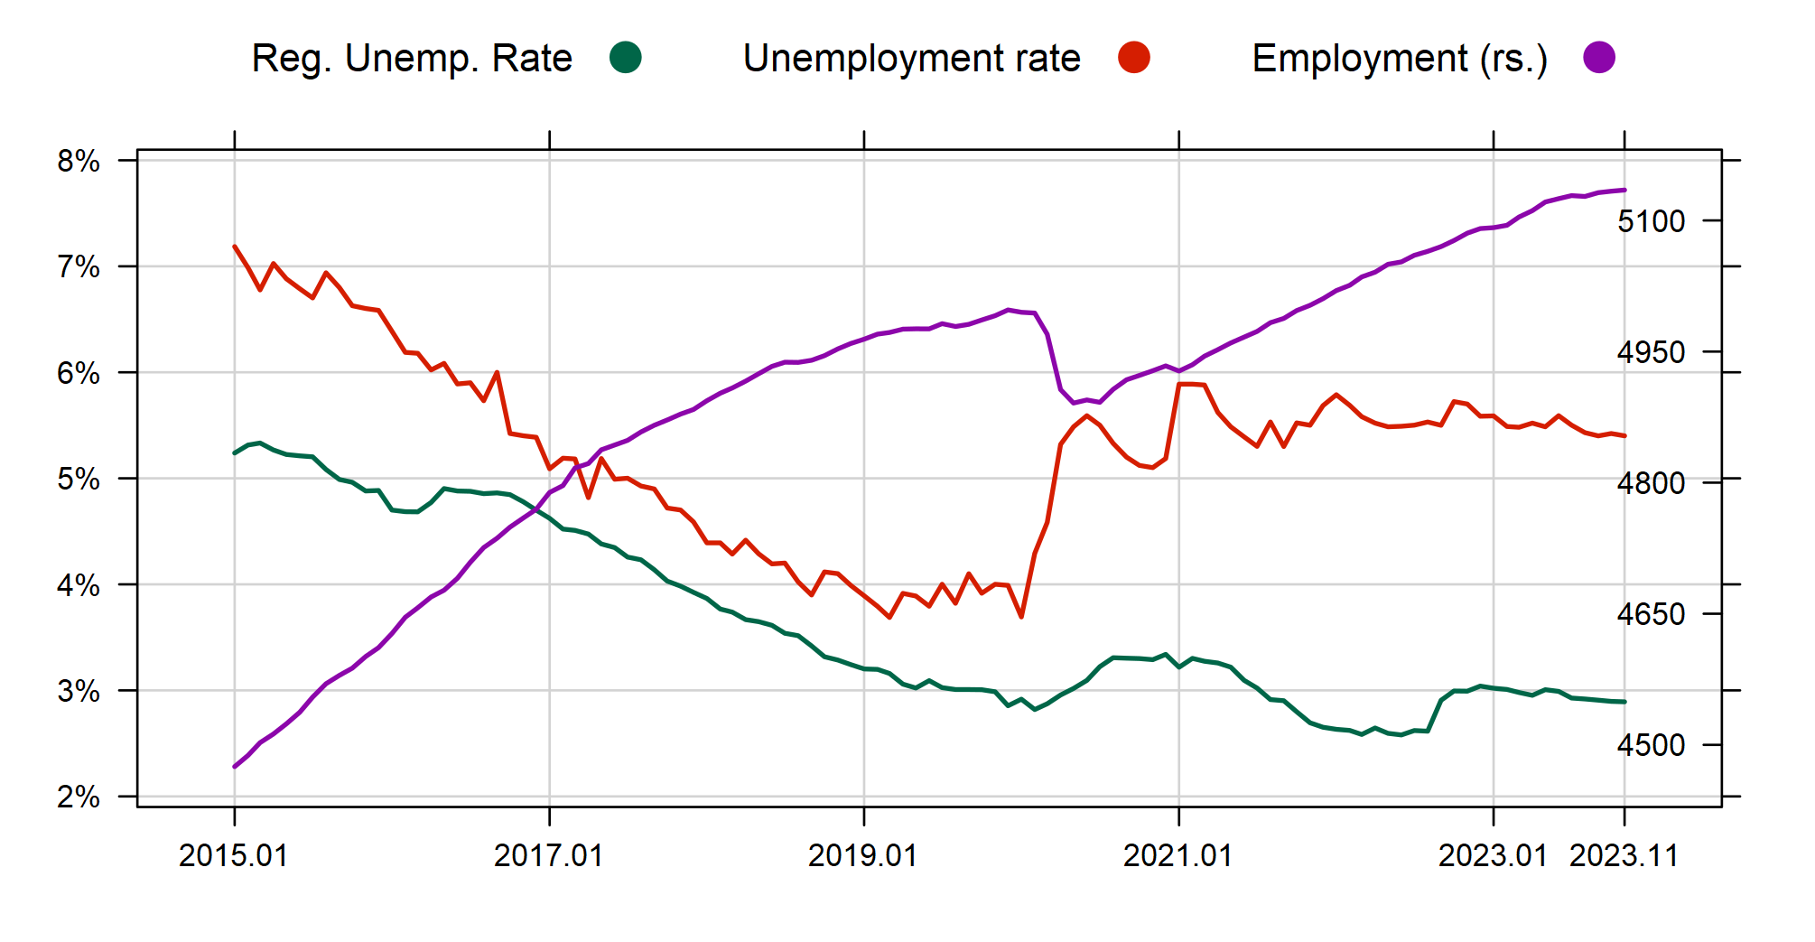
THE LABOUR MARKET IS STILL ROBUST
Monthly employment and unemployment
LABOUR
MARKET
Source: Refinitiv, OTP Bank

Slide 13
… SHOWING NO CLEAR SIGNS OF EASING
Indicators of labor market tightness
LABOUR
MARKET
Source: Refinitiv, OTP Bank

Slide 14
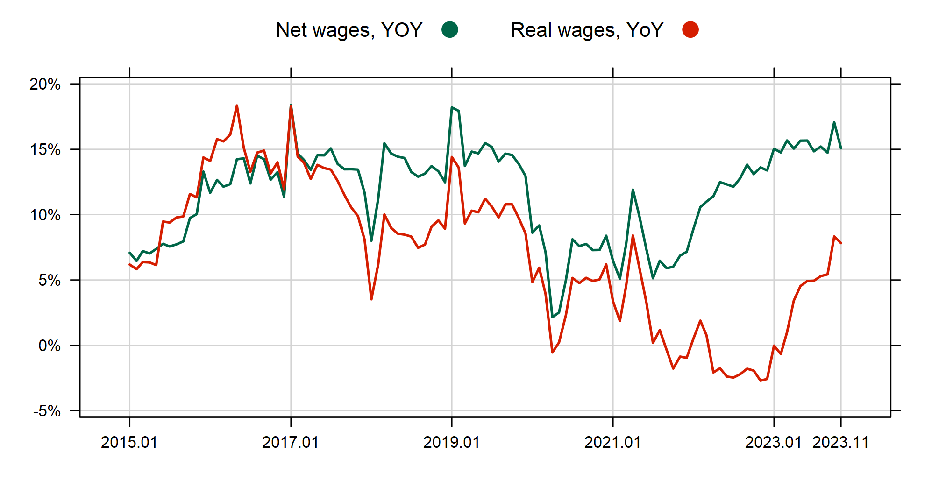
REAL WAGES RISE SHARPLY AS INFLATION FALLS
Nominal and real wage growth
LABOUR
MARKET
Source: Refinitiv, OTP Bank

Slide 15

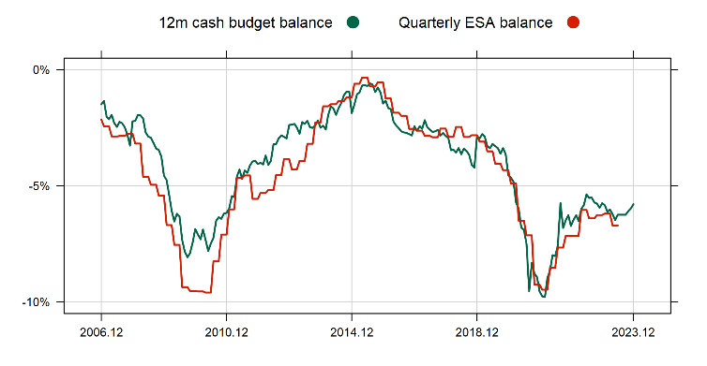
2023 BUDGET DATA SHOWS AROUND 6% DEFICIT, WITH THE NEW PENSION LAW AND ELECTIONS NO CORRECTION IS FORESEEN
Monthly budget balance data and the quarterly ESA balance (% of GDP)
FISCAL
PROCESSES
Source: Refinitiv, OTP Bank

Slide 16

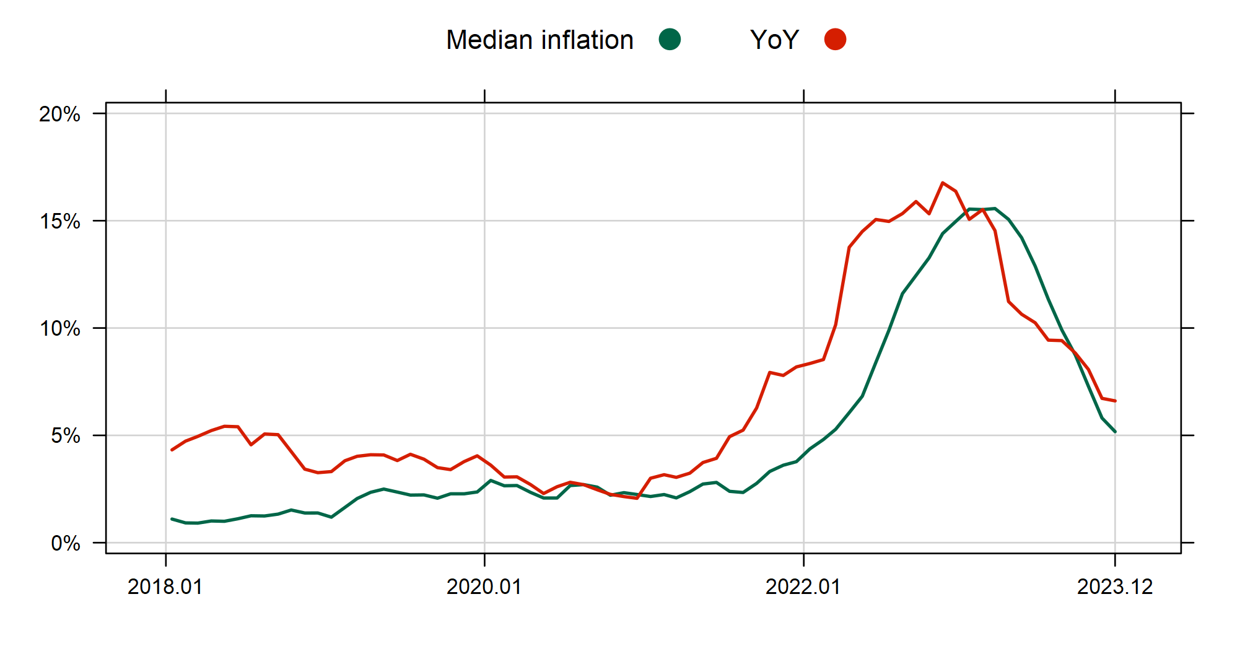
INFLATION IS CLEARLY COMING DOWN
Inflation and core inflation, YoY, %
INFLATION
Source: Refinitiv, OTP Bank

Slide 17
TREND INFLATION IS CURRENTLY 4-5%
Trend inflation indicators, 3 months, annualized, sa, %
INFLATION
Source: Eurostat, OTP Bank

Slide 18
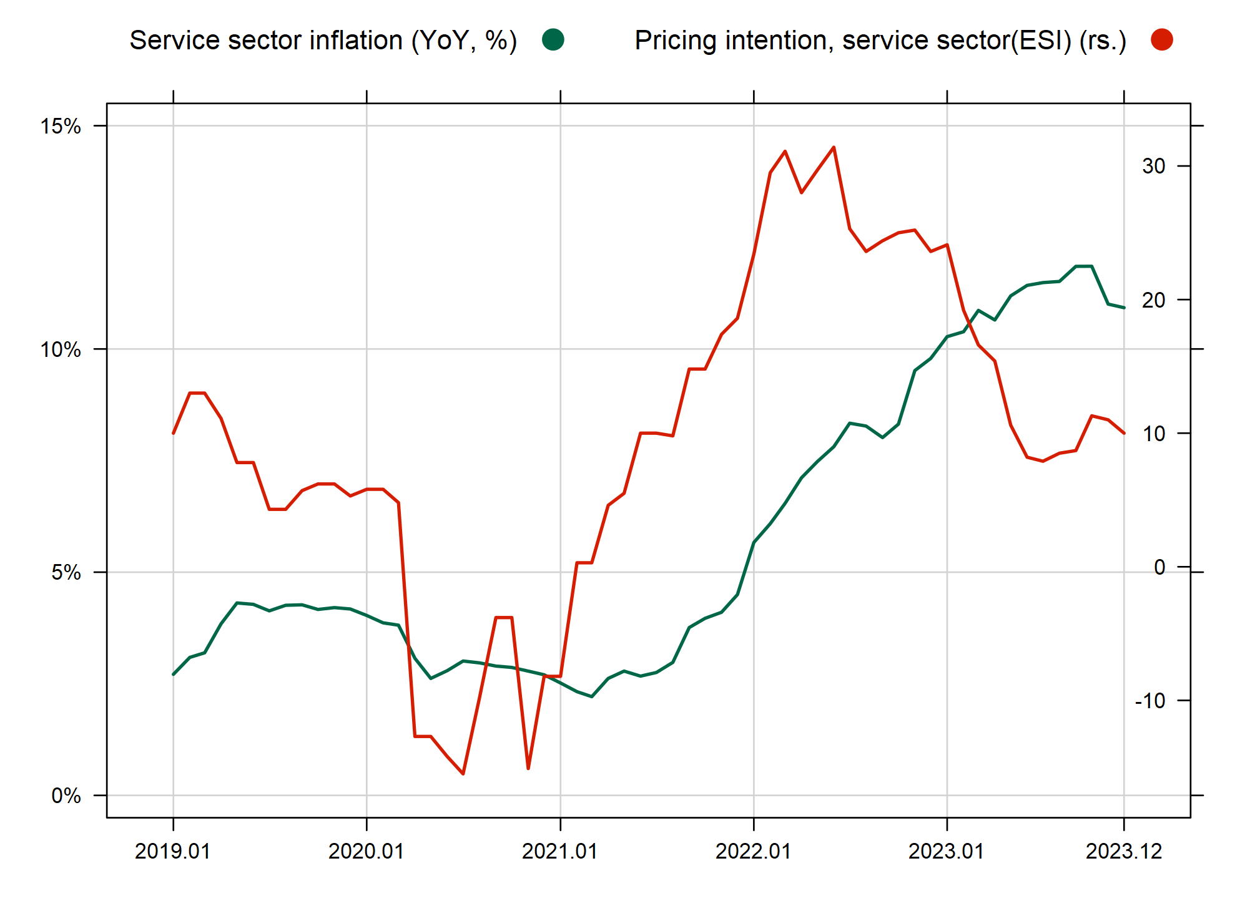
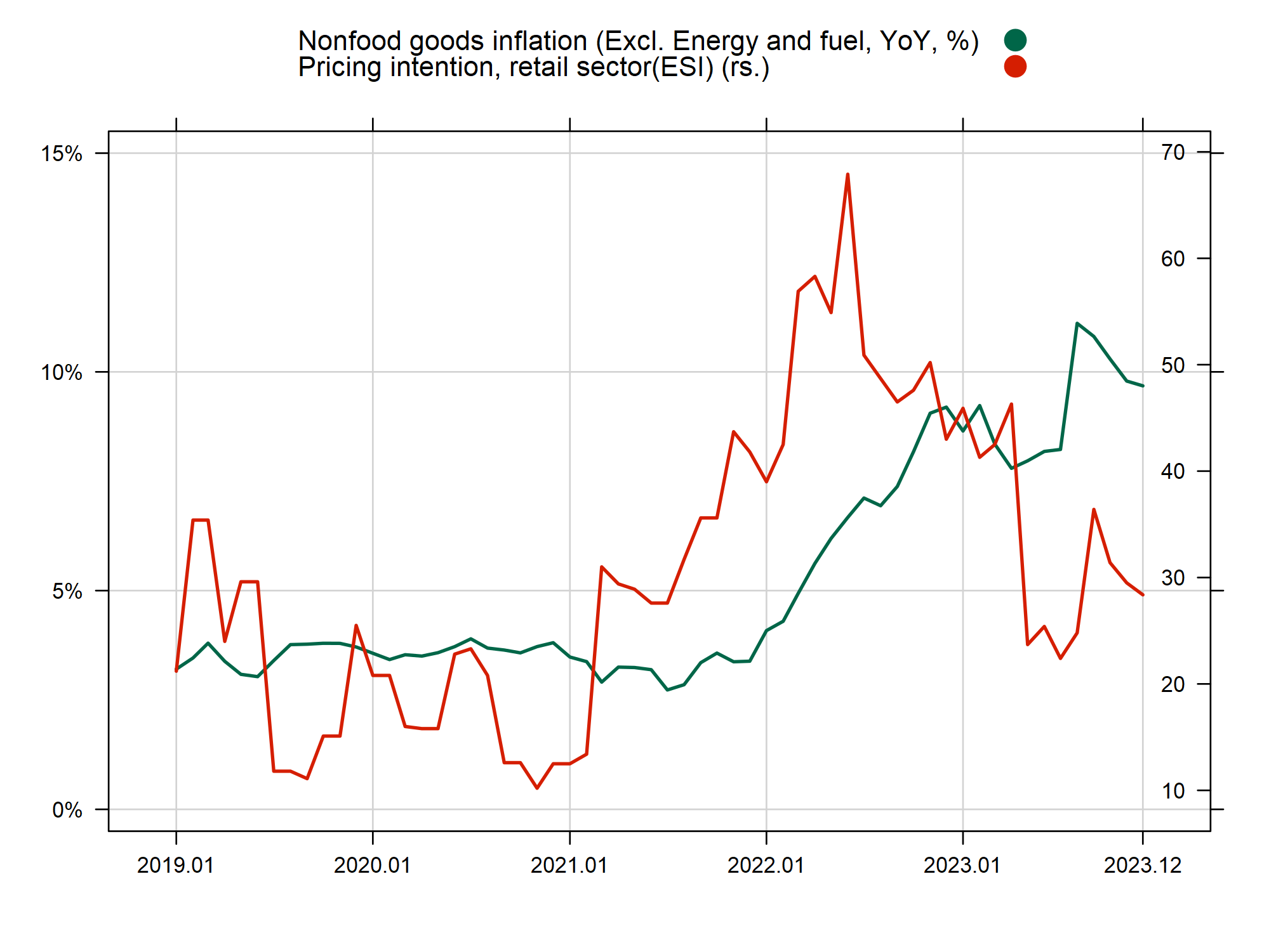
INFLATION
THE DECLINE IN PRICING INTENTIONS HAVE HALTED
Consumer price inflation and pricing intentions
Source: Refinitiv, OTP Bank

Slide 19
JANUARY WILL BRING A TEMPORARY TURNBACK IN DISINFLATION, ON ACCOUNT OF FISCAL MEASURES
Key inflation components, YoY, %
INFLATION
Source: Refinitiv, OTP Bank

Slide 20

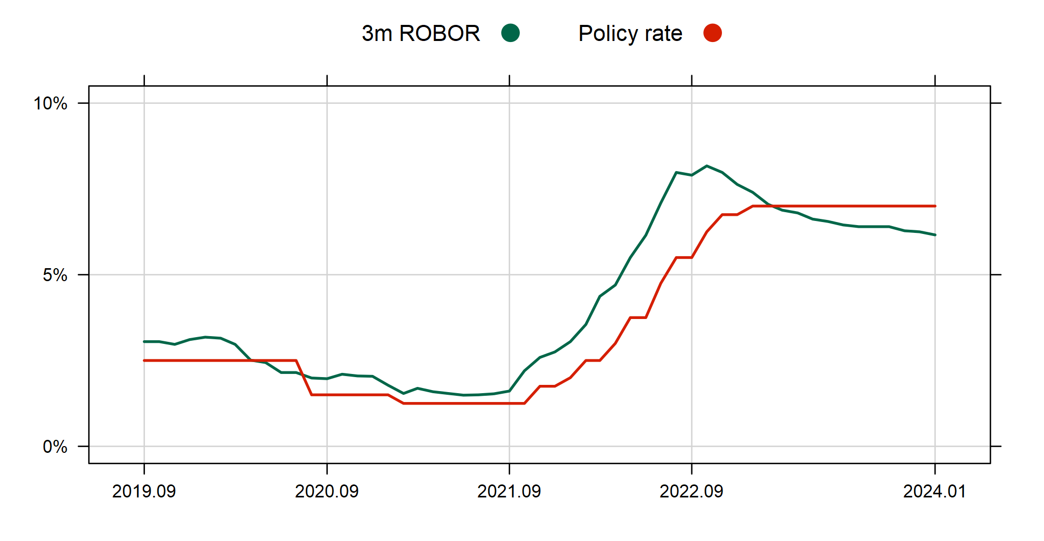
THE BNR HAS CONTINUED TO KEEP THE POLICY RATE, THE 3 MONTH ROBOR HAS STARTED A RENEWED DECLINE
The BNR key interest rate and the 3 months ROBOR, %
MONETARY
POLICY
Source: Refinitive, OTP Bank

Slide 21
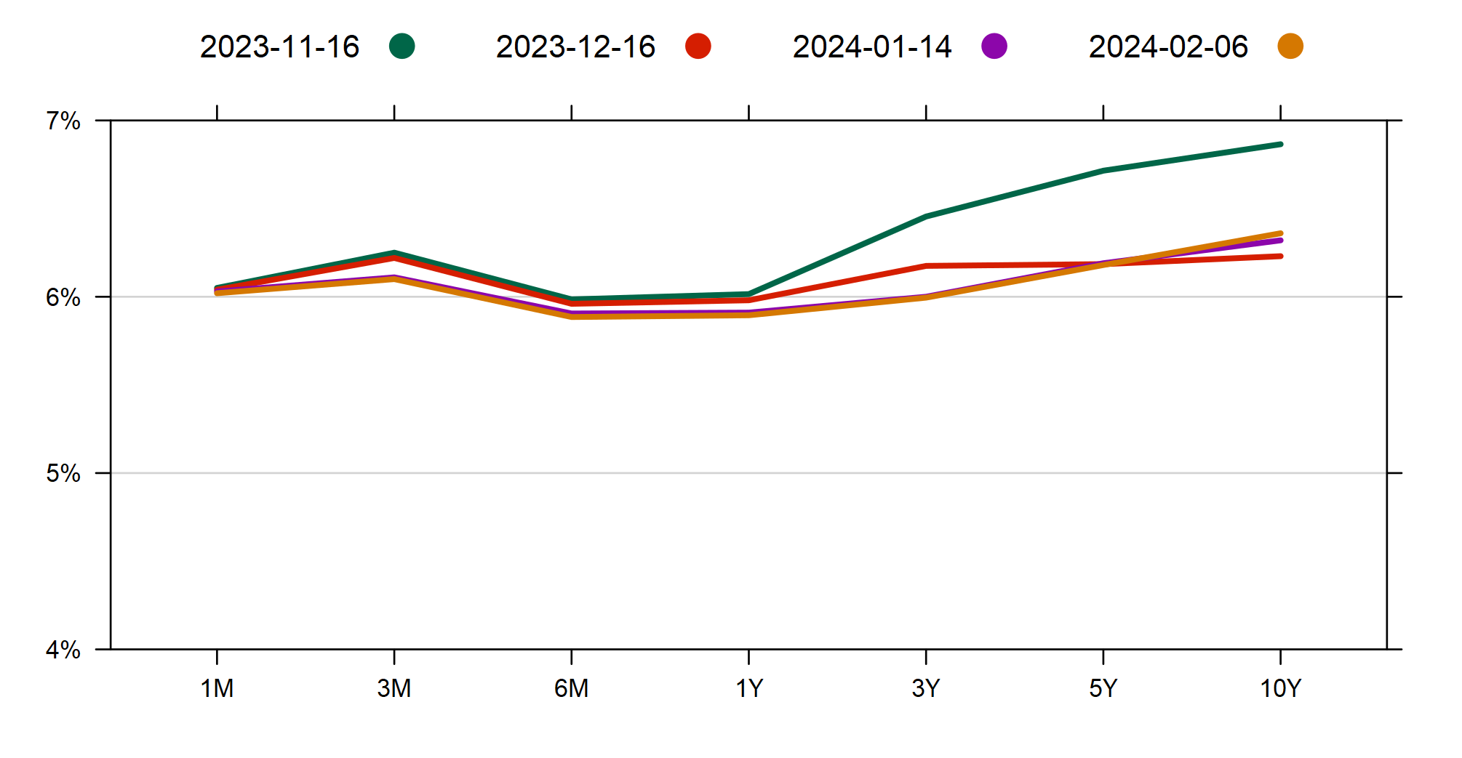
LONG-TERM YIELDS FELL IN LINE WITH INTERNATIONAL DEVELOPMENTS
Yield curve, %
FINANCIAL
MARKETS
Source: BNR, Refinitiv, OTP Bank

Slide 22

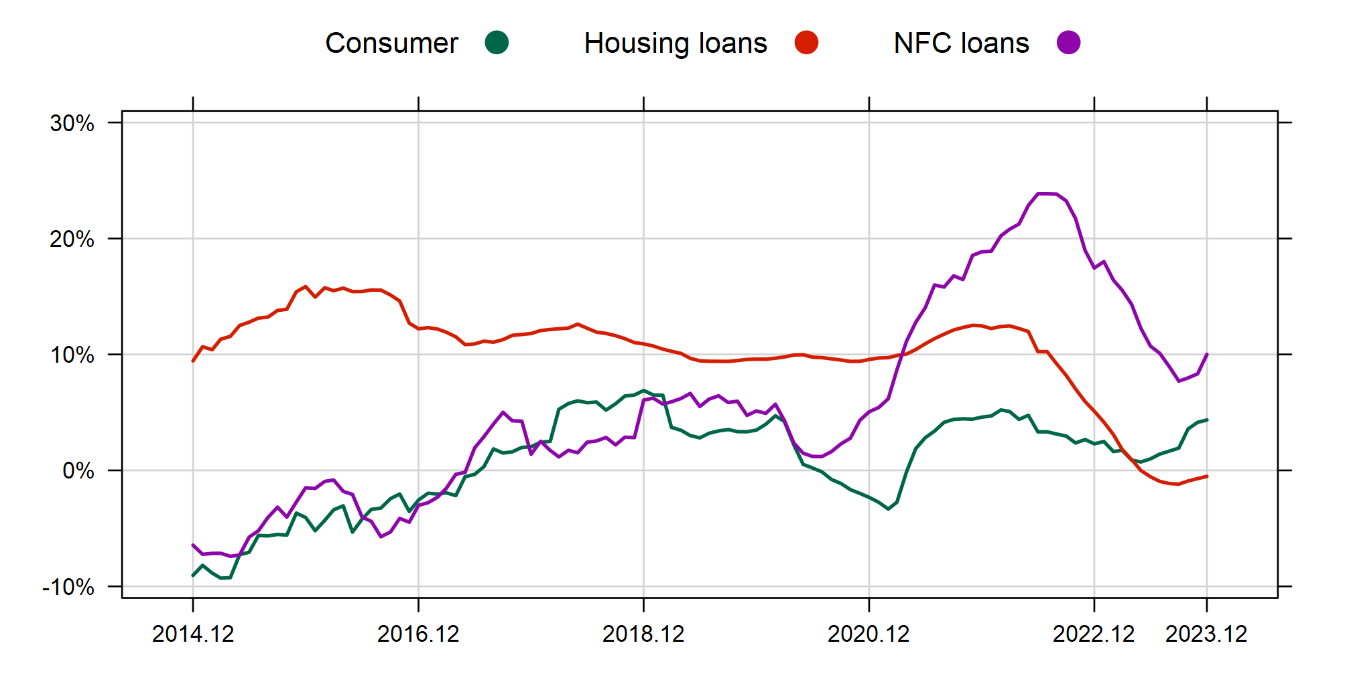
THE CREDIT MARKETS HAVE ALSO BOTTOMED OUT
Corporate and retail credit growth (Y-o-Y; %, without revaluation)
LOAN
MARKETS
Source: Refinitiv, OTP Bank

Slide 23
RoMANIA’S Growth SLOWDOWN PROBABLY BOTTOMED OUT, fiscal measures to halt disinflation temporarILy, fiscal risks increased
GDP growth slowdown probably bottomed out. However, the recovery will be slow as industry and the services sector struggle, and euro area is close to recession
Inflation is declining, but the fiscal measures halt disinflation in January.
The central bank could keep the rate at the current level until 2024H2.
Further fiscal measures are needed to bring the budget deficit in line with the 3% target. The new pension law is a game changer
Credit markets have also started a slow recovery.
PRESS
HIGHLIGHTS

Slide 24


Contributors
&
Mihaly Kovacs
Senior Advisor OTP Bank
Gergely Tardos
Director OTP Bank

Slide 25
12. Legal disclaimer
This report represent the creation and it is the propriety of OTP Bank Nyrt., member of OTP Group. OTP Bank Romania S.A. it is allowed to use, to disclose, to distribute, to copy, to print it, in relation with media and/or customers at its own will and appreciation.
This report contains an aggregate data of several economic factors that could be interpret to estimate new possible trends on the market.
The purpose of this document is only for the information, and we cannot ensure the accuracy and completeness of the information, estimation and data included.
The information presented in this document could be influence by the changes in the international and local financial market, political or economic situation.

Slide 26

Thank you!
Contact: marketing@otpbank.ro

